Slide 1
Best-practice guidelines for reporting diagnostic NGS variants
Fran Smith
Clinical Scientist
Molecular Pathology, King’s College Hospital

Slide 2
Overview:
Background
Whole genome sequencing in context of clinical testing
What we detect
Variant classification systems and guidelines
ACGS
ACMG
Terminology
Functional effects
What significance do these variants have?
Evidence we can use to interpret variants
Effect on protein
Splice site prediction tools
Missense variants
Databases
Frequency
Functional assays
Segregation
Variant confirmation and validation
What it means to be ‘diagnostic’

Slide 3
Context
Genetics in diagnosis of disease has been very expensive
Pre 2012 £600 for one or two genes
Can now order a whole exome for about the same price
Genetic testing was only undertaken when the clinician was fairly sure of the diagnosis
Now we can sequence all the genes and relate to phenotype after

Slide 4
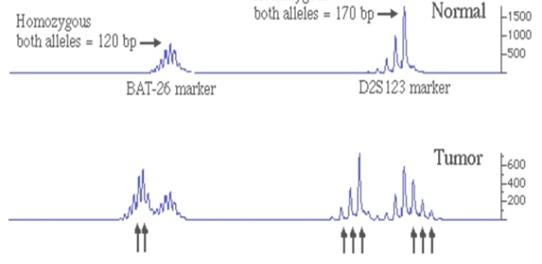
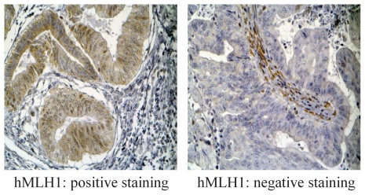
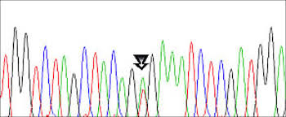
Example: Lynch syndrome testing pathway
Microsatellite instability testing in tumour DNA
If high
Immunohistochemistry for loss of mismatch repair proteins
If loss
BRAF p.Val600Glu
If negative
MLH1 promoter methylation
If negative
Germline DNA testing MLH1, MSH2, MSH6, PMS2

Slide 5
Whole genome sequencing (WGS)
Only ~1 % of the genome codes for proteins
Many other functional elements
Numbers of variants expected from 1 genome:
Type of variant | Average number in European | Average number in African
SNP | 3.53 million | 4.31 million
Indel | 546k | 625k
Large deletion | 939 | 1.1k
CNV | 157 | 170
Non-synonymous | 10.2k | 12.2k
Synonymous | 11.2k | 13.8k
Intronic | 1.68 million | 2.06 million
Data from 1000 genomes project
Notes:
Must also consider other types of variation: epigenetics

Slide 6

Out of all these variants…which ones cause disease???
We must name them systematically (HGVS)
We must classify them using a standard evidence based approach

Slide 7
HGVS nomenclature
Must be called against a reference sequence
RefSeq
LRG – Locus Reference Genomic
Genome build
g. is for genomic locations c. is for coding DNA sequence
p. is for protein
m. is for mitochondrial DNA
Coding nomenclature is where c.1 is the first base of the translation initiation codon

Slide 8
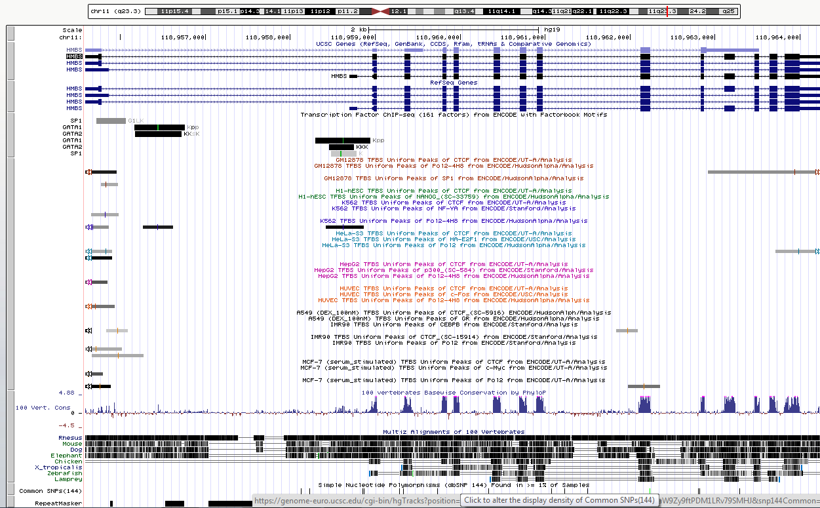
Transcripts

Slide 9
Classification – UK & US system
Class | Description | Report wording
1 | Clearly not pathogenic Benign | Not reported
2 | Unlikely to be pathogenic Likely benign | Diagnosis not confirmed
3 | Uncertain significance | Diagnosis not confirmed or excluded
4 | Likely to be pathogenic | Consistent with diagnosis
5 | Certainly pathogenic | Confirms diagnosis

Slide 10
Terms used to describe sequence variants
Pathogenic - contributes mechanistically to disease, but is not necessarily fully penetrant
Damaging - alters the normal levels or biochemical function of a gene or gene product – not necessarily causative
Deleterious - reduces the reproductive fitness of carriers, targeted by purifying natural selection
Benign – not harmful in effect

Slide 11
Key considerations
What is the expected inheritance pattern?
Autosomal dominant
Autosomal recessive
X-linked
De novo
What is the mechanism of pathogenicity?
Loss of function
Gain of function
Haploinsufficiency
What is the frequency of the disease?
Can you rule out common variants (>1%)?

Slide 12
Evidence base for classification
ACMG (American College of Medical Genetics) have very useful descriptive classification system:
Pathogenic |  | Example
PVS1 | Very Strong | Nonsense variant
PS1-6 | Strong | Well established functional assay
PM1-6 | Moderate | In mutational hotspot
PP1-5 | Supporting | Cosegregates with disease
Benign |  | Example
BA1 | Stand-alone | Allele frequency >5%
BS1-4 | Strong | Lack of effect on functional assay
BP1-7 | Supporting | Observed in trans with pathogenic variant

Slide 13
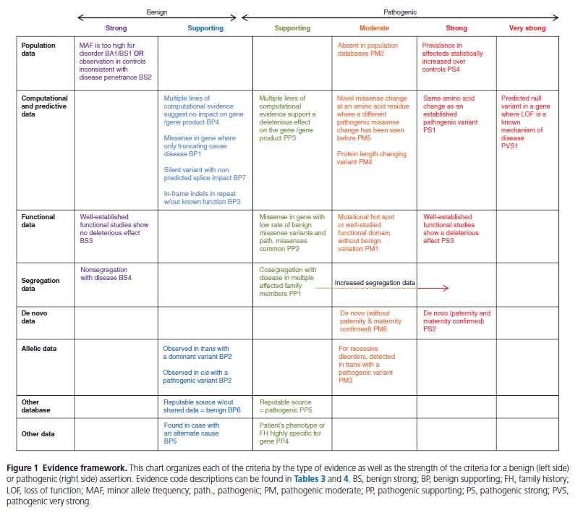

Slide 14
What effect does the variant have?
Is it in a region known to be functional?
Protein coding regions
Flanking splice site
Promoter
However we know from ENCODE that there are many more regions of the genome that are functional
In a known functional region = more likely to be pathogenic

Slide 15
Types of variant that will severely affect the protein …there are always exceptions
Nonsense
Premature stop codons – nonsense mediated decay (NMD)
Frameshift
Translated protein scrambled – often results in NMD
Canonical splice site
Causes exon skipping and loss of functional domains or frameshift

Slide 16
Nonsense
Normal sequence
DNA sequence
ATG
Met
GGA
Gly
AGA
Arg
CCG
Pro
TCC
Ser
TGA
*
Protein sequence
Mutated sequence c.7A>T
DNA sequence
ATG
Met
GGA
Gly
TGA
*
Loss of part of functional part of protein = likely to be pathogenic
Protein sequence

Slide 17
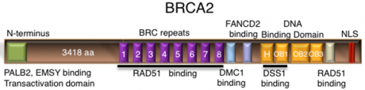
Exception to the rule…
A truncating variant in the last exon
BRCA2: c.9976A > T (p.Lys3326*)
Protein is still functional
Common in European population
Was mistakenly assigned as a pathogenic variant
Always be aware of the context of your mutation within the gene

Slide 18
Frameshift
Scrambled reading frame = likely to be pathogenic
Normal sequence
DNA sequence
ATG
Met
GGA
Gly
AGA
Arg
CCG
Pro
TCC
Ser
TGA
*
Protein sequence
Mutated sequence c.7delT
DNA sequence
ATG
Met
GGA
Gly
GAC
Asp
CGT
Arg
CCT
Pro
GA…
…..
Protein sequence

Slide 19
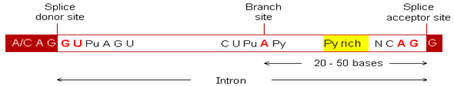
Splice site
Affects splicing = likely to be pathogenic
Splicing is all about recognition of sequence motifs by the spliceosome:
Variants in the consensus splice site can lead to exon skipping or incorporation of intronic sequence into the mRNA transcript
Cryptic splice sites can also be activated

Slide 20
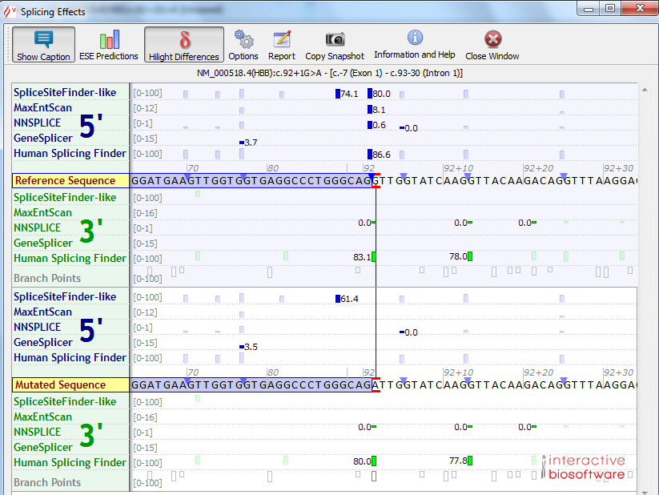
Splice site prediction software

Slide 21
Subtle effects on protein - missense
Substituting one amino acid for another
Can affect functional part of protein
Adding or removing cysteine alters potential for forming disulphide bridges
Grantham distance: a measure of physiochemical difference
Large physiochemical difference = more likely to be pathogenic

Slide 22
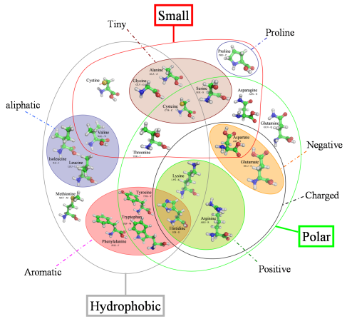
Amino acid properties

Slide 23
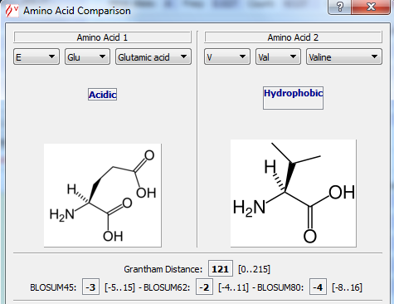
Grantham distance

Slide 24
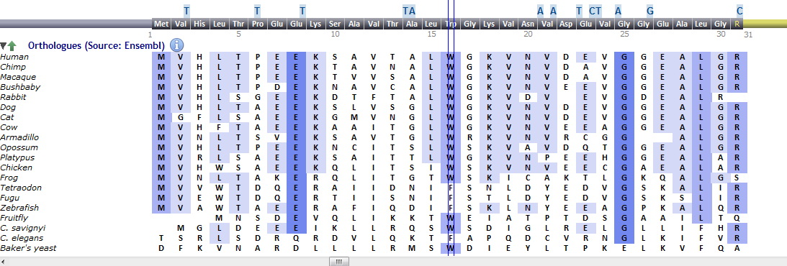
Multiple sequence alignments
Assessment of evolutionary conservation
More conserved = more important for function
Not conserved = less likely to be pathogenic

Slide 25
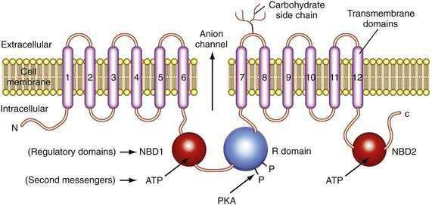
Protein domains/mutational hotspots
CFTR protein structure
In important protein domain = more likely to be pathogenic

Slide 26
Missense prediction tools
In silico prediction
SIFT – Sorting intolerant from tolerant
PolyPhen
AlignGVGD
MutationTaster
All are based upon physiochemical differences, position in the protein and multiple sequence alignments or a combination
Use with CAUTION
Never use in isolation
Very difficult to tell anything from missense prediction tools!

Slide 27
HBB c.20A>T; p.Glu7Val HbS Sickle
One example exemplifies why you must consider ALL THE DATA
Missense
4.85% in African population (ExAC)
Weakly conserved nucleotide (phyloP: 0.04 [-14.1;6.4])
Moderately conserved amino acid (considering 20 species)
Moderate physicochemical difference between Glu and Val (Grantham dist.: 121 [0-215])
This variant is in protein domain: Globin, subset
Align GVGD: C0 (GV: 164.97 - GD: 0.00)
SIFT: Tolerated (score: 0.1, median: 2.21)
MutationTaster: polymorphism (p-value: 1)

Slide 28
Databases
Reported as pathogenic = more likely to be pathogenic
Leiden Open Variation database LOVD
Human Gene Mutation Database HGMD
ClinVar
Online Mendelian Inheritance in Man OMIM
DECIPHER
Many smaller disease specific databases
Considerations
Is it curated/updated?
HGVS nomenclature and transcript
Validated data
Source and independence of the observations listed
Always reassess their data

Slide 29
Variant frequency
Higher frequency = less likely to be pathogenic
Probably one of the most useful ways of assigning classes 1 and 2 (not pathogenic)
Consider the incidence of the disease vs variant frequency and inheritance
Several large databases that hold variant frequency data
ExAC – Exome Aggregation consortium
dbSNP
EVS – Exome variant server
According to ACMG: >5% freq is stand-alone support for classification as benign

Slide 30
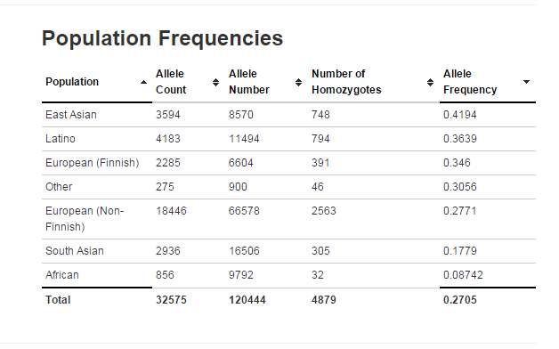
Example:
You find a variant at 36% in the Latino population in ExAC
What are your considerations?

Slide 31
Functional assays
Effect seen functionally = more likely to be pathogenic
Can be very useful in looking at the in vivo effect of a variant
Many metabolic enzymes have robust functional assays
Pyruvate kinase
mRNA sequencing very good at predicting effects of splicing variants

Slide 32
Example:
You find a PKLR class 3 missense in trans with a class 5 in a patient with haemolytic anaemia
PKLR activity can be assayed on a fresh EDTA sample
PKLR assay shows the patient to be deficient
This data can help to re-classify the class 3 variant as pathogenic

Slide 33
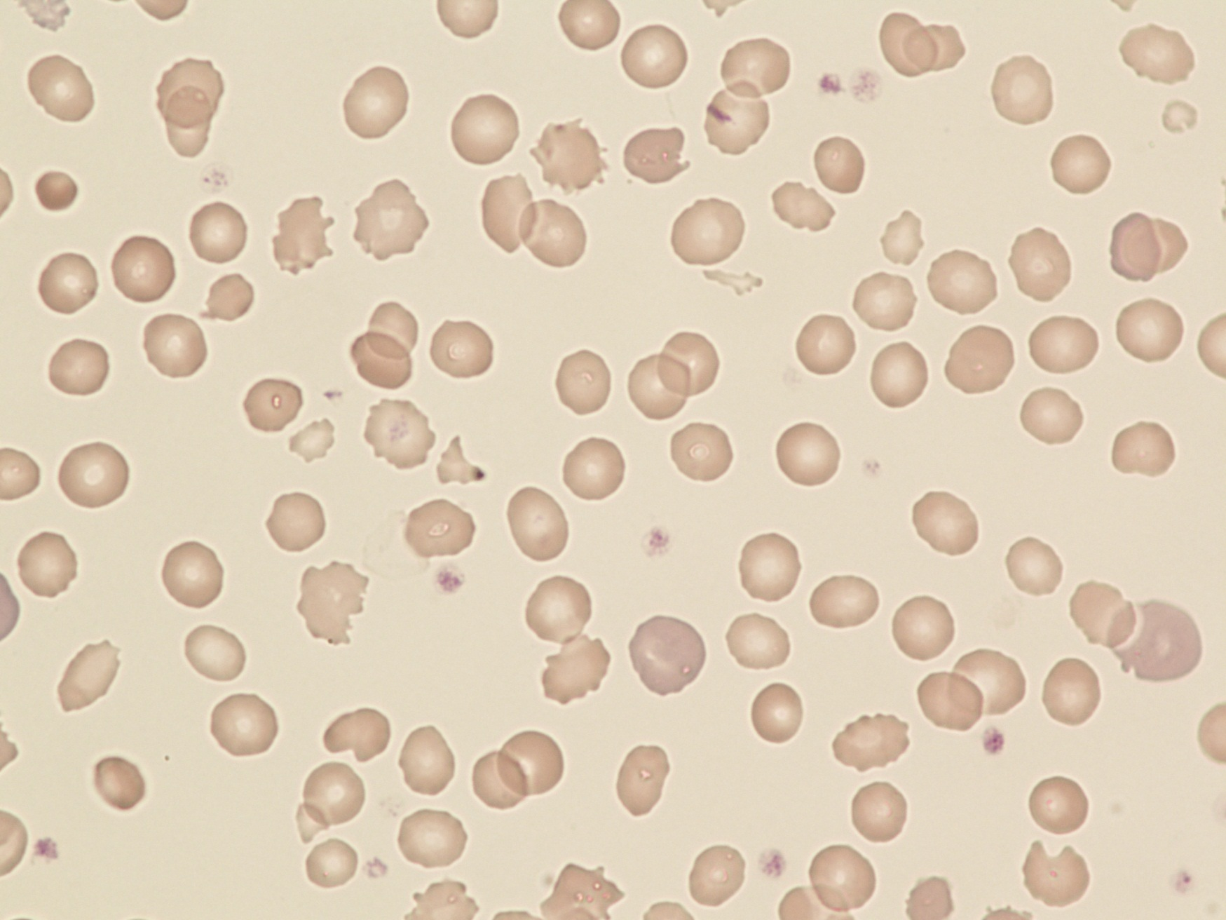
Blood film: You are looking at the functional effect

Slide 34
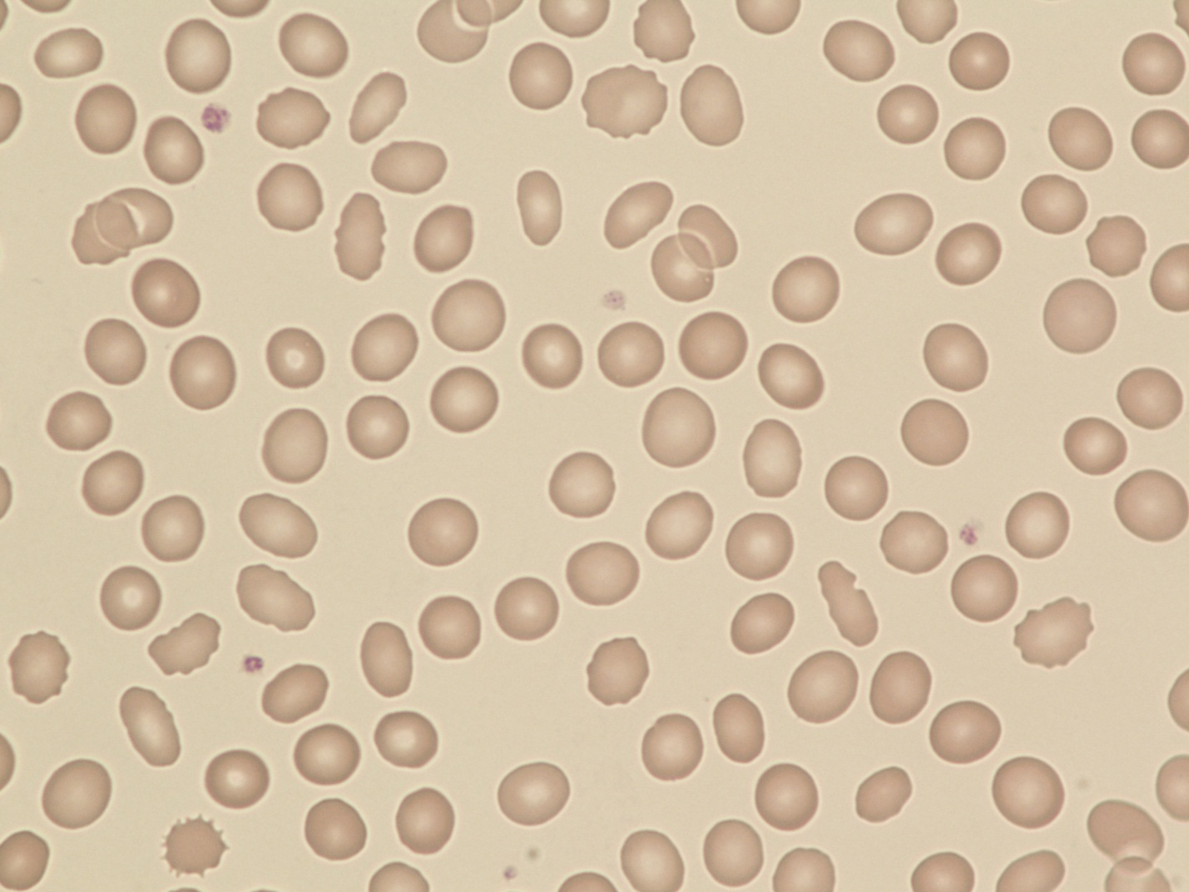
Mother:
Homozygous SPTA1: c.[5572C>G; 6531-12C>T]; p.[Leu1858Val;?] Low expression allele

Slide 35
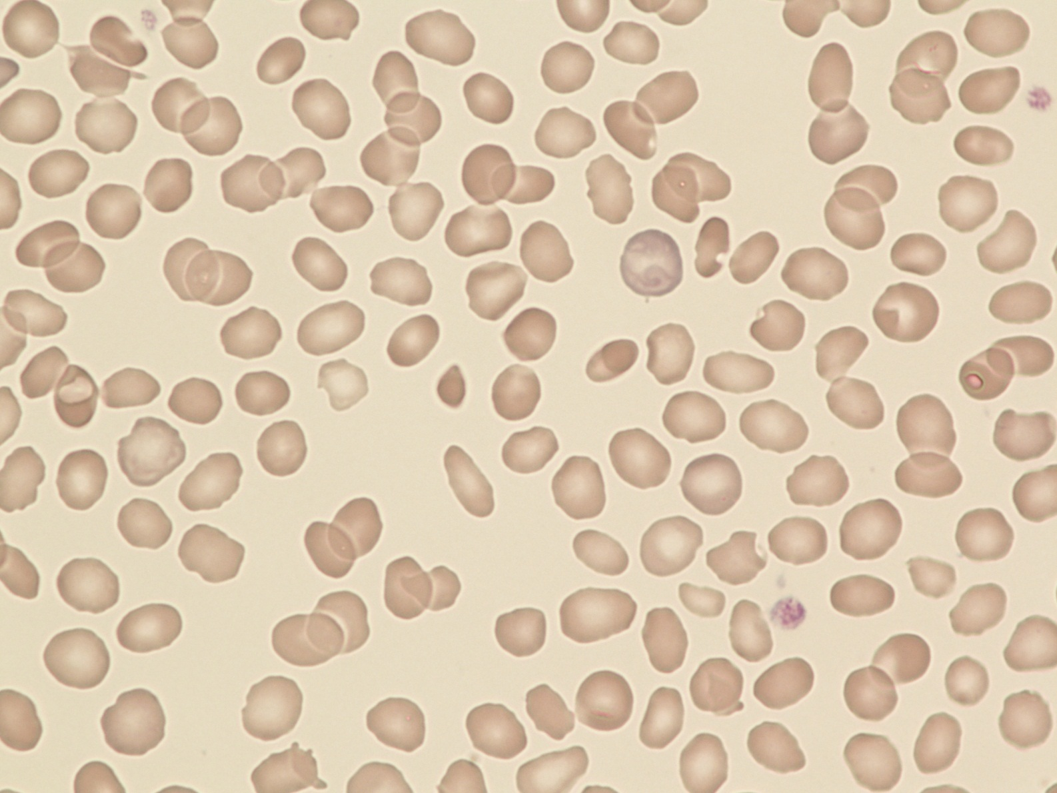
Father:
Heterozygous SPTA1: c.83G>A; p.Arg28His

Slide 36
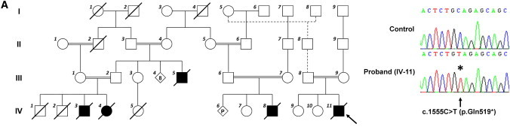
Segregation
Segregates with disease in family = more likely to be pathogenic
Found in unaffected = less likely to be pathogenic
Is it in cis/trans with other variants in the patient?
Testing of other affected or unaffected family members

Slide 37
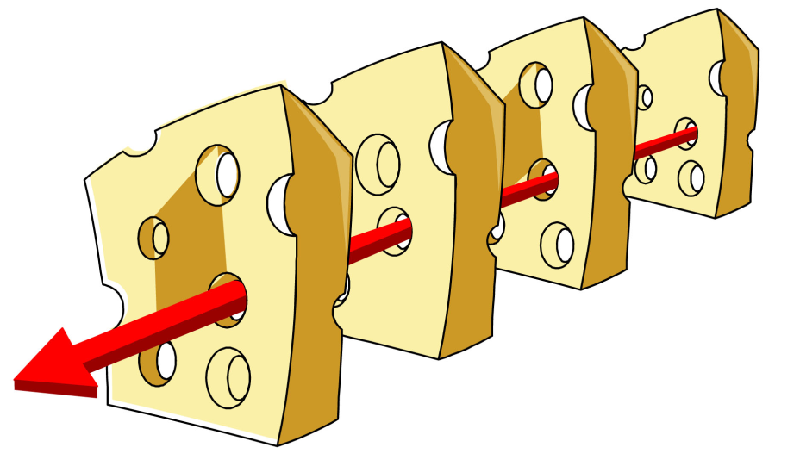
Diagnostic validation of results
What does it mean to be ‘diagnostic’?
ISO15189 accreditation for quality standards
The cheese model
We confirm a variant by Sanger sequencing
Reassess pathogenicity in relation to phenotype
Report

Slide 38
What should be included on the clinical report?
Results
HGVS nomenclature
Gene name, cDNA, protein
Disease
Inheritance
Interpretation
Evidence supporting variant classification
Does it explain the patient’s phenotype?
Supplementary testing

Slide 39
Report…
Methodology
Laboratory and analysis tools used
Limitations
Risk to offspring
Referral for genetic counselling
Incidental findings??

Slide 40
Incidental findings
Much debate on if we should report pathogenic variants that are not associated with the condition that the patient has been referred for
Eg Cystic Fibrosis carrier status
Eg Late onset dominant disorders such as BRCA
For 100k the patient will decide at consent

Slide 41
Examples
Hereditary spastic paraplegia referral
Heterozygous REEP1 variant c.471del p.(Thr158fs)
What questions will you ask?

Slide 42
Is this gene known to be associated with the condition?
Yes
Mode of inheritance?
Autosomal dominant
How big is the gene?
7 exons
Where does the variant lie in the gene
Penultimate exon

